Slide 1
Bias-Corrected Q-Learning
With Multistate Extension
Donghun Lee ,Warren B. Powell , IEEE TRANSACTIONS ON AUTOMATIC CONTROL
授課教授： 李慶鴻 教授
講者： 曾揚
日期： 2021/6/21

Slide 2
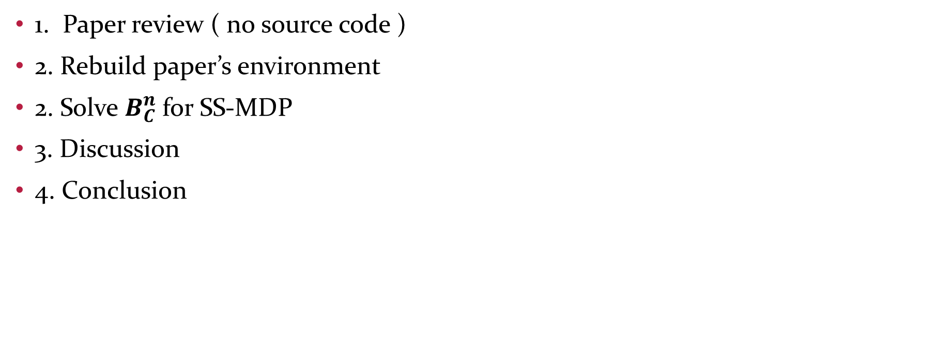
Outline
1. Paper review ( no source code )
2. Rebuild paper’s environment
2. Solve $B_{C}^{n}$for SS-MDP
3. Discussion
4. Conclusion

Slide 3
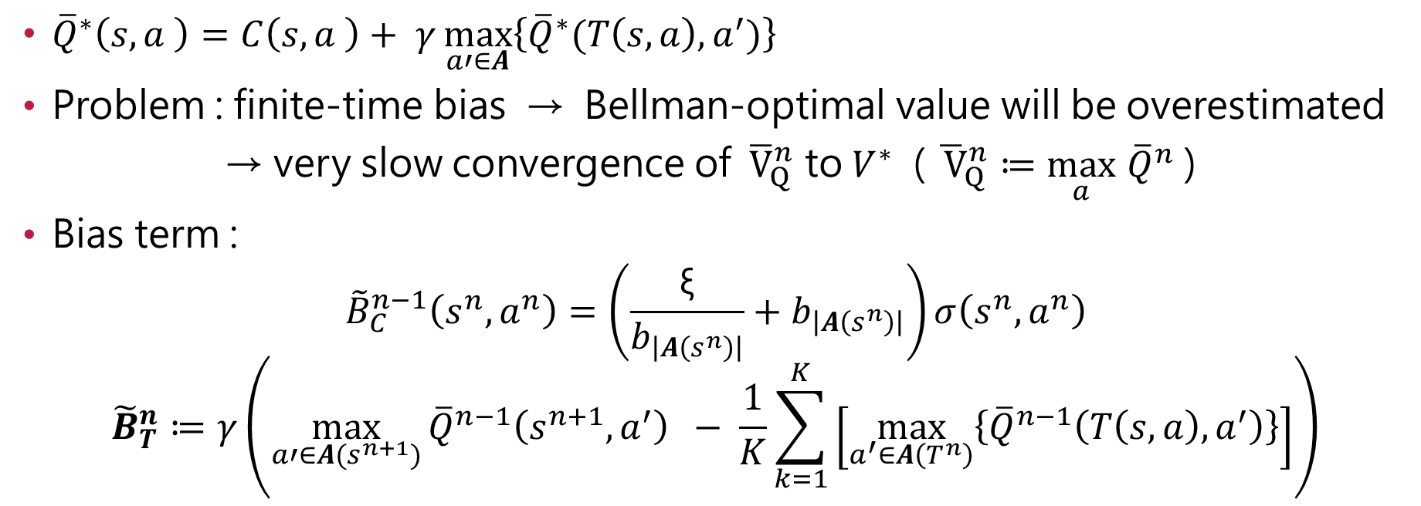
1. Paper review
${\overline{Q}}^{∗}\left(s,a \right)=C\left(s,a \right)+ γ\max_{a′∈A}\left\{{\overline{Q}}^{∗}(T\left(s,a\right),a^{′})\right\}$
Problem : finite-time bias → Bellman-optimal value will be overestimated
→ very slow convergence of ${\overline{V}}_{Q}^{n}$ to $V^{∗}$ ( ${\overline{ V}}_{Q}^{n}≔\max_{a}$ ${\overline{Q}}^{n}$ )
Bias term :
$${\tilde{B}}_{C}^{n−1}\left(s^{n},a^{n}\right)=\left(\frac{\text{ξ}}{b_{\left|A\left(s^{n}\right)\right|}}+b_{\left|A\left(s^{n}\right)\right|}\right)σ\left(s^{n},a^{n}\right)$$
$${\tilde{B}}_{T}^{n}≔γ\left(\max_{a′∈A(s^{n+1})}{{\overline{Q}}^{n−1}\left(s^{n+1},a^{′}\right)} − \frac{1}{K}\sum_{k=1}^{K}{\left[\max_{a^{′}∈A\left(T^{n}\right)}\left\{{\overline{Q}}^{n−1}\left(T\left(s,a\right),a^{′}\right)\right\}\right]}\right)$$

Slide 4
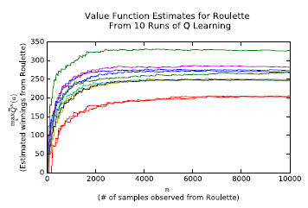
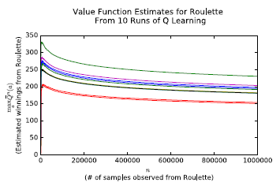
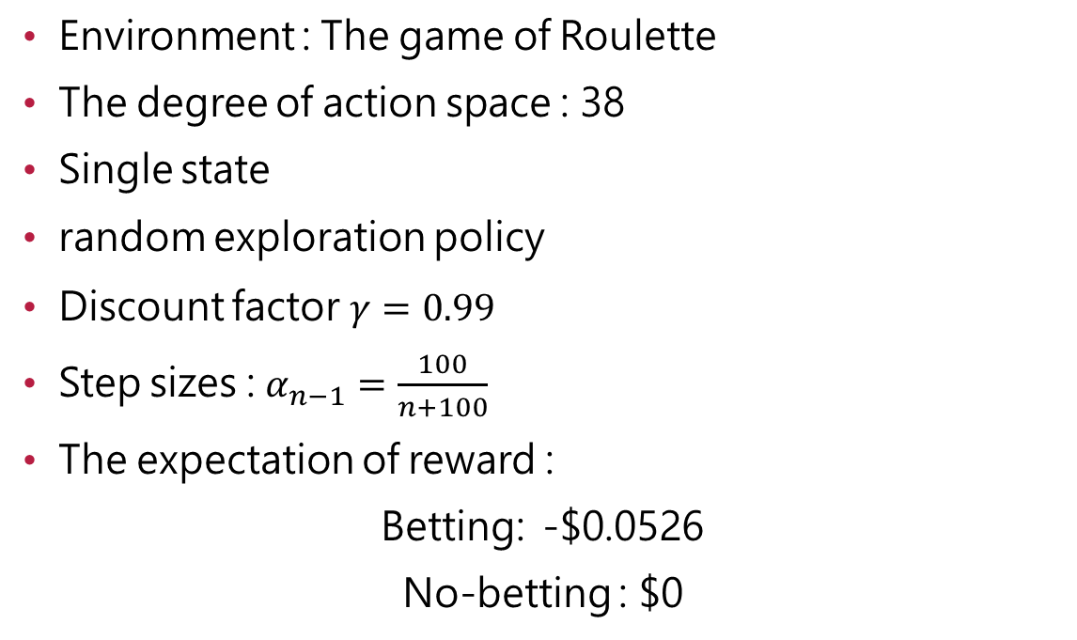
2. Rebuild Paper’s Environment
Environment : The game of Roulette
The degree of action space : 38
Single state
random exploration policy
Discount factor $γ=0.99$
Step sizes : $α_{n−1}=\frac{100}{n+100}$
The expectation of reward :
Betting: -$0.0526
No-betting : $0

Slide 5
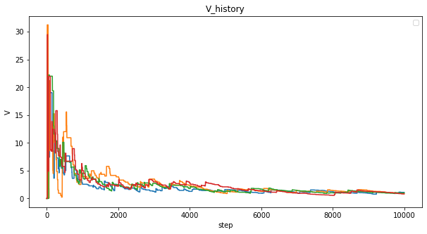
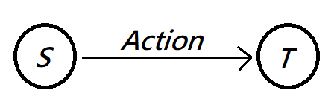



One-step Bias
Betting: -$0.0526
No-betting : $0
Bias exist !!

Slide 6
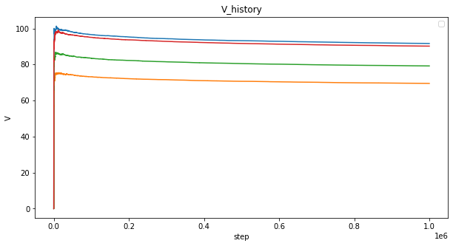
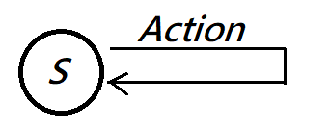
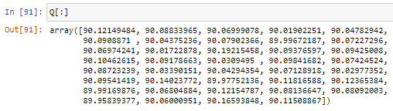
Multi-step Bias
Ideal Value = 0

Slide 7
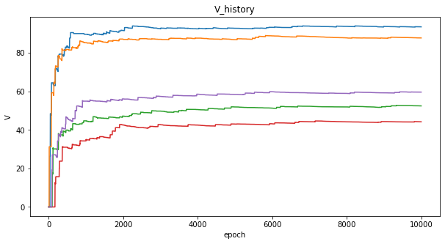
Comparison
Step = 1 ~ 10000 ( 前1% )
Paper’s Our

Slide 8
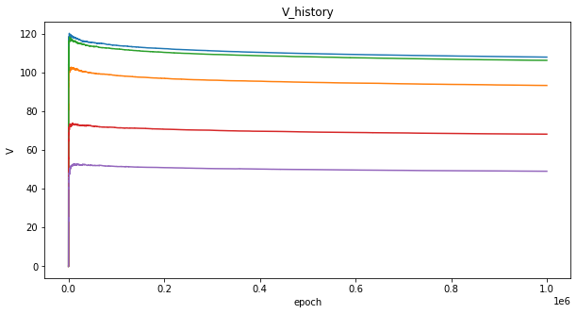
Comparison
Step = 1 ~ 1000000 (all)
Paper’s Our

Slide 9
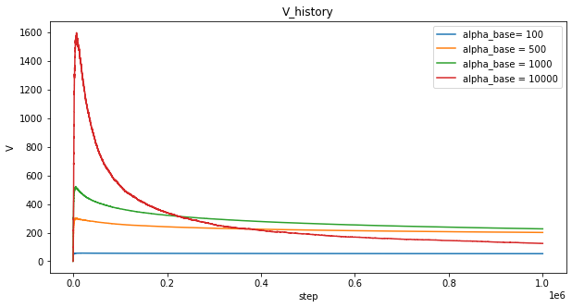
Parameter modified
In paper, $α_{n−1}=\frac{100}{n+100}$

Slide 10
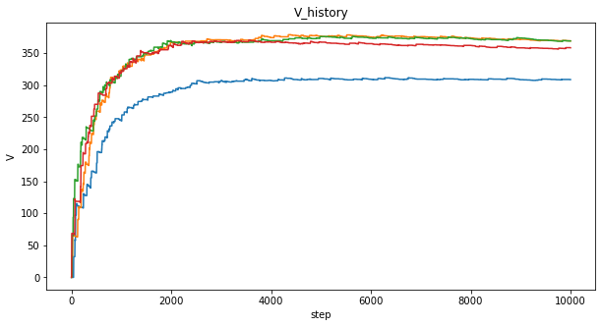
Comparison
Step = 1 ~ 10000 ( 前1% )
Paper’s Our (alpha_base = 400)

Slide 11
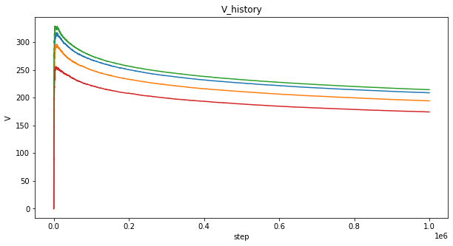
Comparison
Step = 1 ~ 1000000 (all)
Paper’s Our (alpha_base = 400)

Slide 12
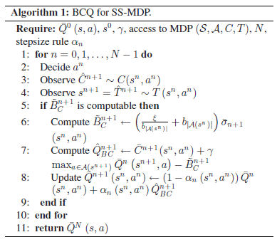
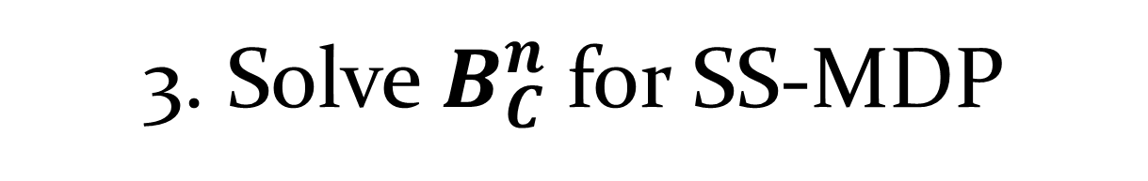
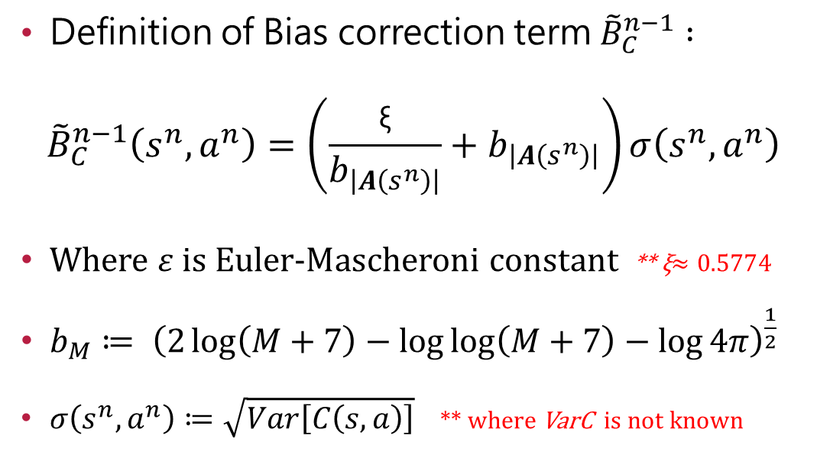
3. Solve $B_{C}^{n}$for SS-MDP
Definition of Bias correction term ${\tilde{B}}_{C}^{n−1} :$
$${\tilde{B}}_{C}^{n−1}\left(s^{n},a^{n}\right)=\left(\frac{\text{ξ}}{b_{\left|A\left(s^{n}\right)\right|}}+b_{\left|A\left(s^{n}\right)\right|}\right)σ\left(s^{n},a^{n}\right)$$
Where $ε$ is Euler-Mascheroni constant ** ξ$≈0.5774$
$b_{M}≔ {\left(2\log\left(M+7\right)−\log{\log\left(M+7\right)}−\log{4π}\right)}^{\frac{1}{2}}$
$σ\left(s^{n},a^{n}\right)≔\sqrt{Var\left[C\left(s,a\right)\right]}$ ** where VarC is not known

Slide 13
Paper’s result

Slide 14
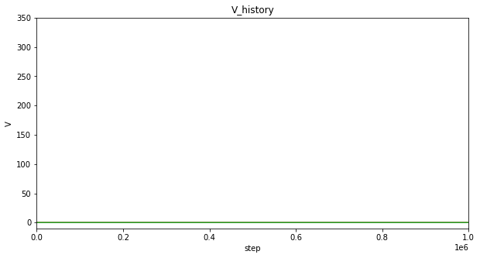
Comparison
Paper’s Our (alpha_base = 400)

Slide 15
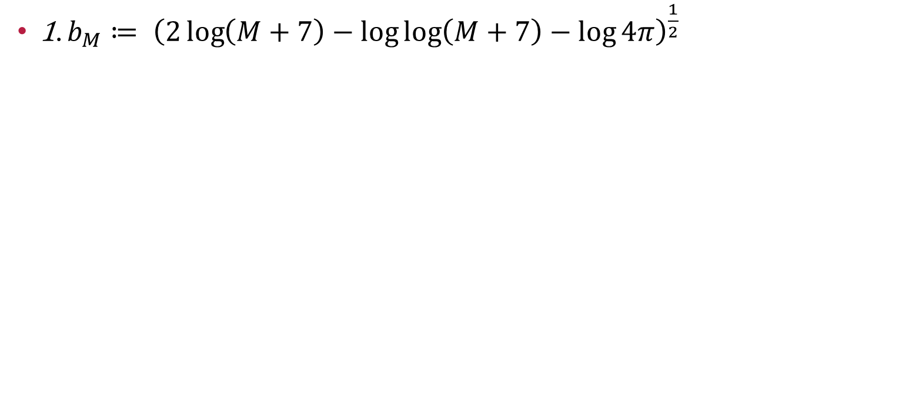
4.Discussion
1. $b_{M}≔ {\left(2\log\left(M+7\right)−\log{\log\left(M+7\right)}−\log{4π}\right)}^{\frac{1}{2}}$

Slide 16
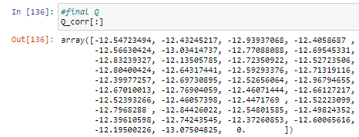
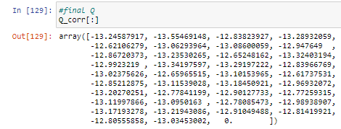
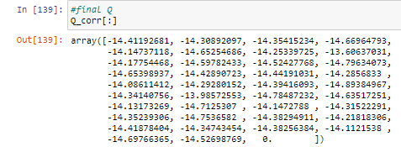
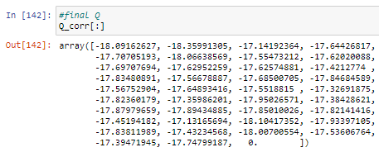
Discussion
Constant = 0
Constant = 7
Constant = 50
Constant = 500

Slide 17
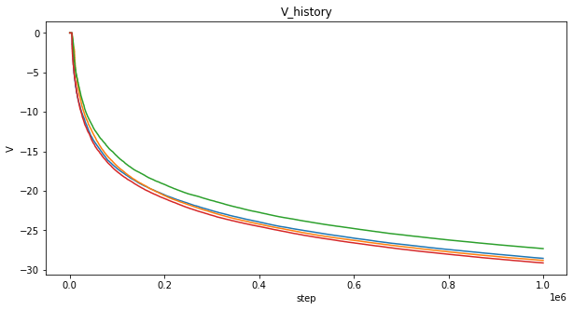
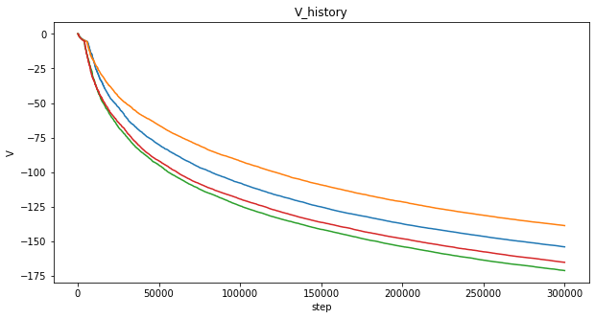
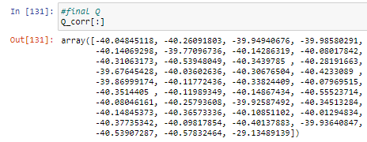
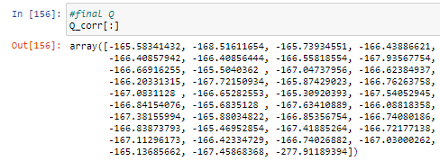
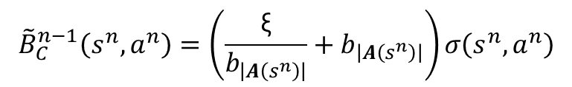
Discussion
It’s really corrected ?
$${\tilde{B}}_{C}^{n−1}\left(s^{n},a^{n}\right)=\left(\frac{\text{ξ}}{b_{\left|A\left(s^{n}\right)\right|}}+b_{\left|A\left(s^{n}\right)\right|}\right)σ\left(s^{n},a^{n}\right)$$
The reward of no-bet = normal(0,1)
The reward of no-bet = normal(0,50)

Slide 18
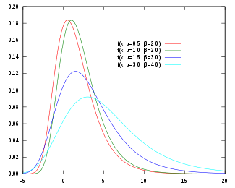
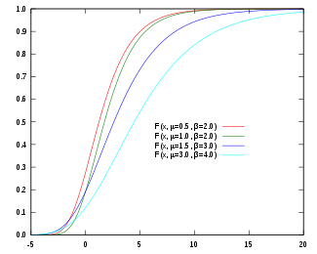
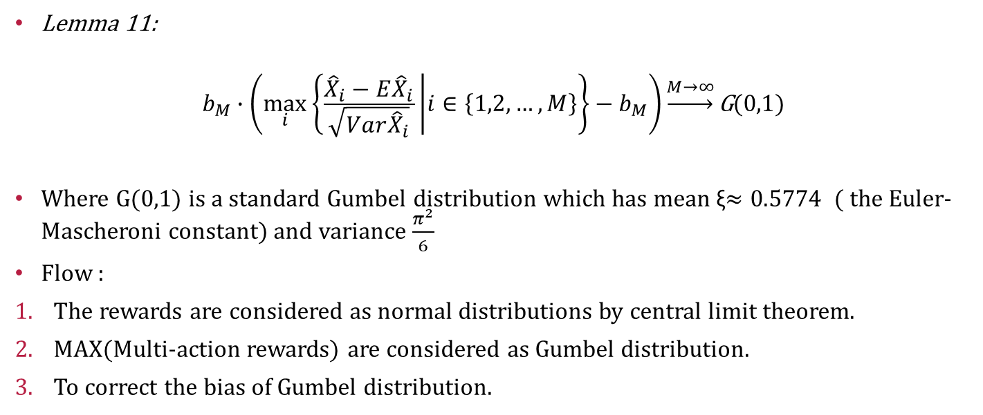
Discussion
Lemma 11:
$$b_{M}∙\left(\max_{i}\left\{\frac{{\hat{X}}_{i}−E{\hat{X}}_{i}}{\sqrt{Var{\hat{X}}_{i}}} | i∈\left\{1,2,…,M\right\}\right\}−b_{M}\right)\underset{→}{M→∞}\text{G}\text{(0,1)}$$
Where G(0,1) is a standard Gumbel distribution which has mean ξ$≈0.5774$ ( the Euler-Mascheroni constant) and variance $\frac{π^{2}}{6}$
Flow :
The rewards are considered as normal distributions by central limit theorem.
MAX(Multi-action rewards) are considered as Gumbel distribution.
To correct the bias of Gumbel distribution.

Slide 19
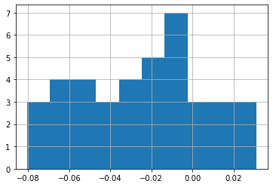
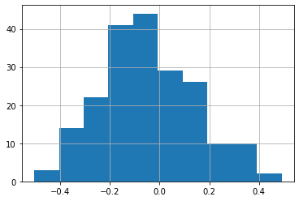
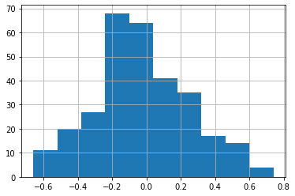
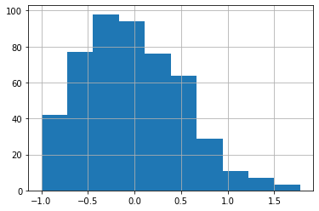
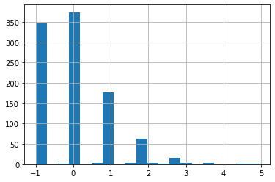
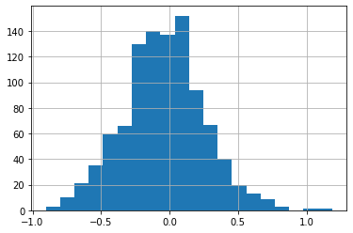
Discussion
** reward = -0.0526*spot+spot-1
Spot = 38 ,Step = 1M
Spot = 200 ,Step = 1M
Spot = 300 ,Step = 1M
Spot = 500 ,Step = 1M
Spot = 1000 ,Step = 1M
Spot = 1000 ,Step = 10M

Slide 20
5. Conclusion
1. The method of the theorem could be against its motivation.
2. The result of mine is the same as the paper, but it can’t get a good performence on other environment.
3. The method needs more experiments to proof that it can work.

Slide 21
Thanks for your attention.

